Slide 1

Safe Message System
Conner Hansen
Alex Summer
Andreas Floeck

Slide 2
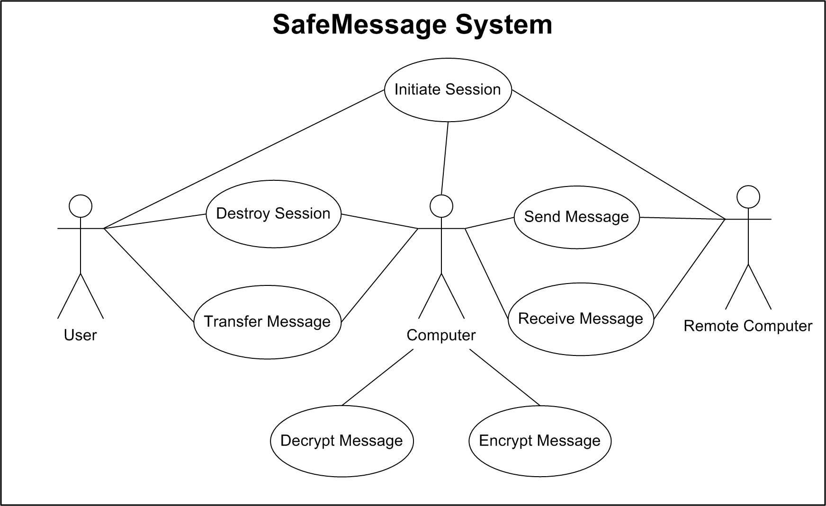
Use Case Diagram

Slide 3
Utility Tree (1)
Security
  Session-level encryption (H)
  User-level encryption (H)
  Unspoofable communication path (H)
  User authentication (M)
Reliability (Fault Tolerance)
  Guarantee delivery of messages (H)
  Logging system (L)
  Available P2P network (L)

Slide 4
Utility Tree (2)
Usage
  Selectable security level (H)
  Broadcast message (M)
  Store message (M)
Maintainability
  Updatable security algorithms (M)
  Updatable network routines (M)
  Bugfixes, update system (H)
Modifiability
  Easy to change GUI (L)

Slide 5
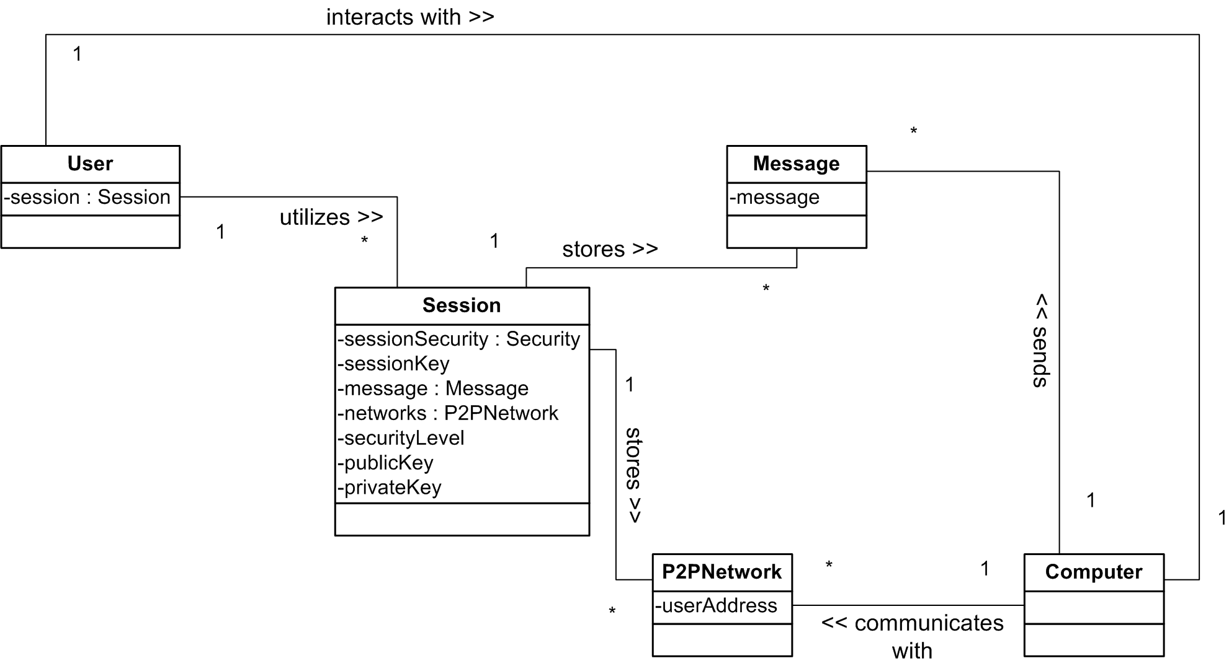
Integrated Security Attributes (Cauliflower)

Slide 6
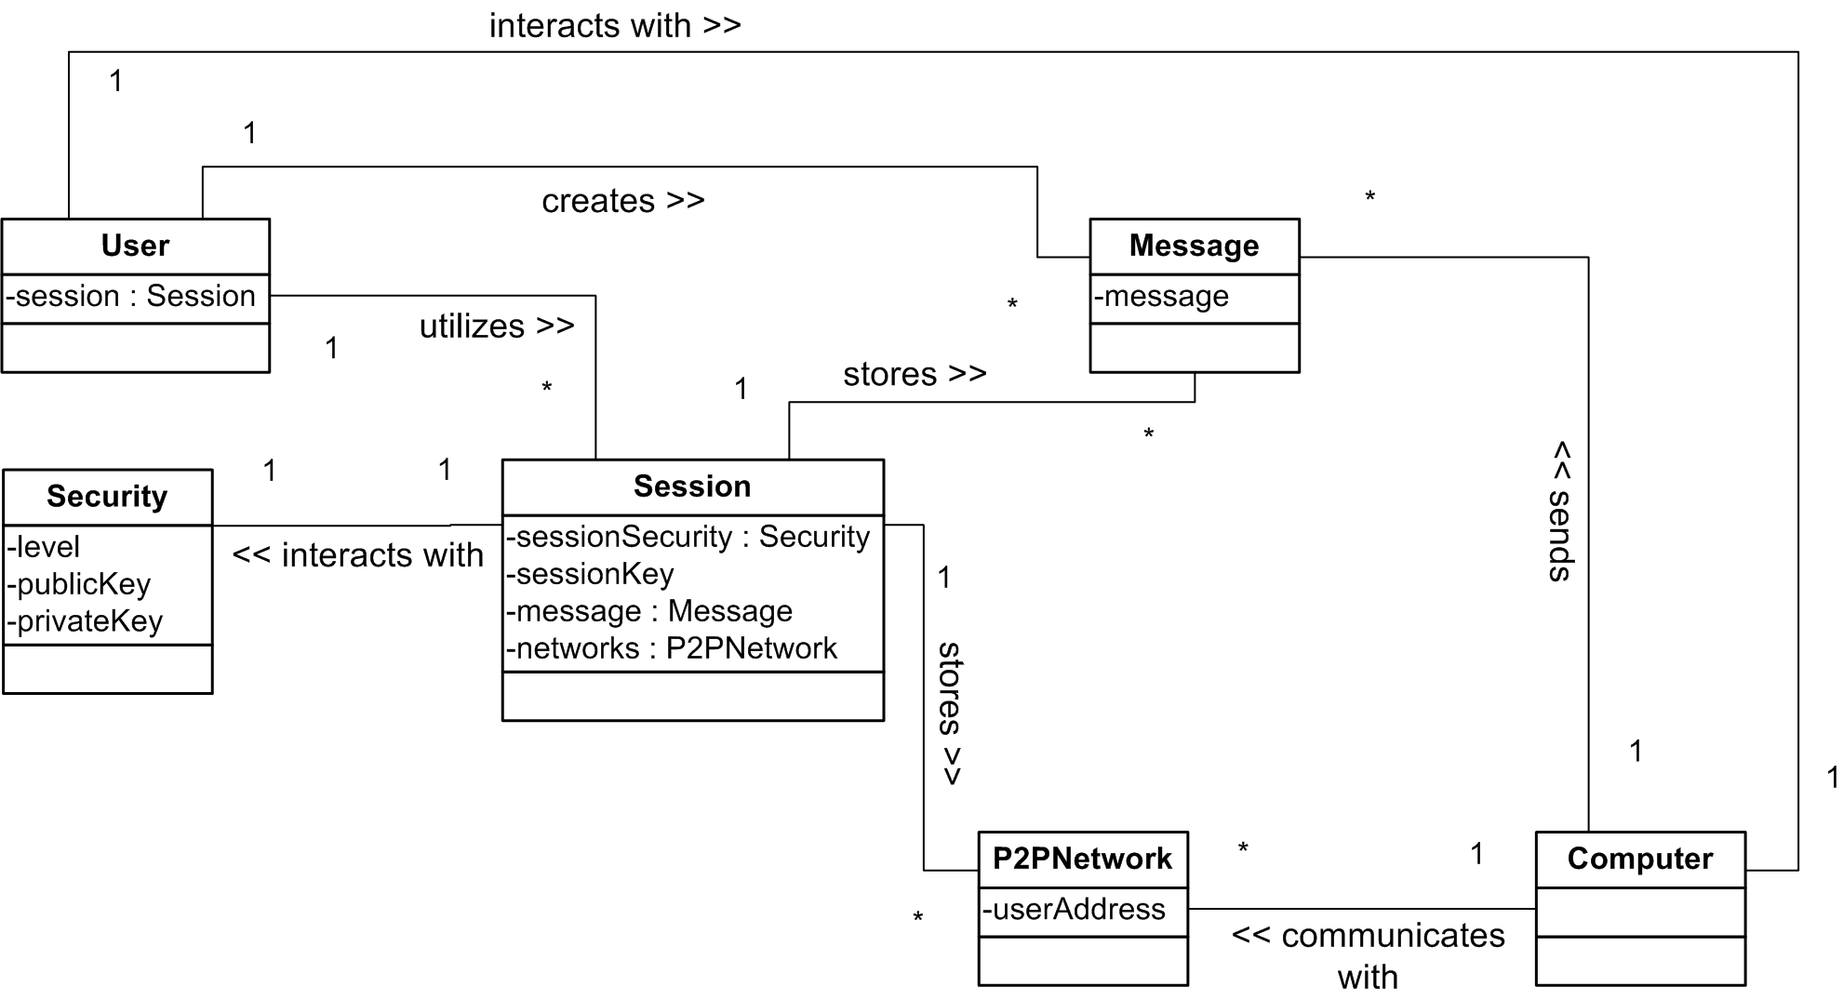
External Security Class (SecX)

Slide 7
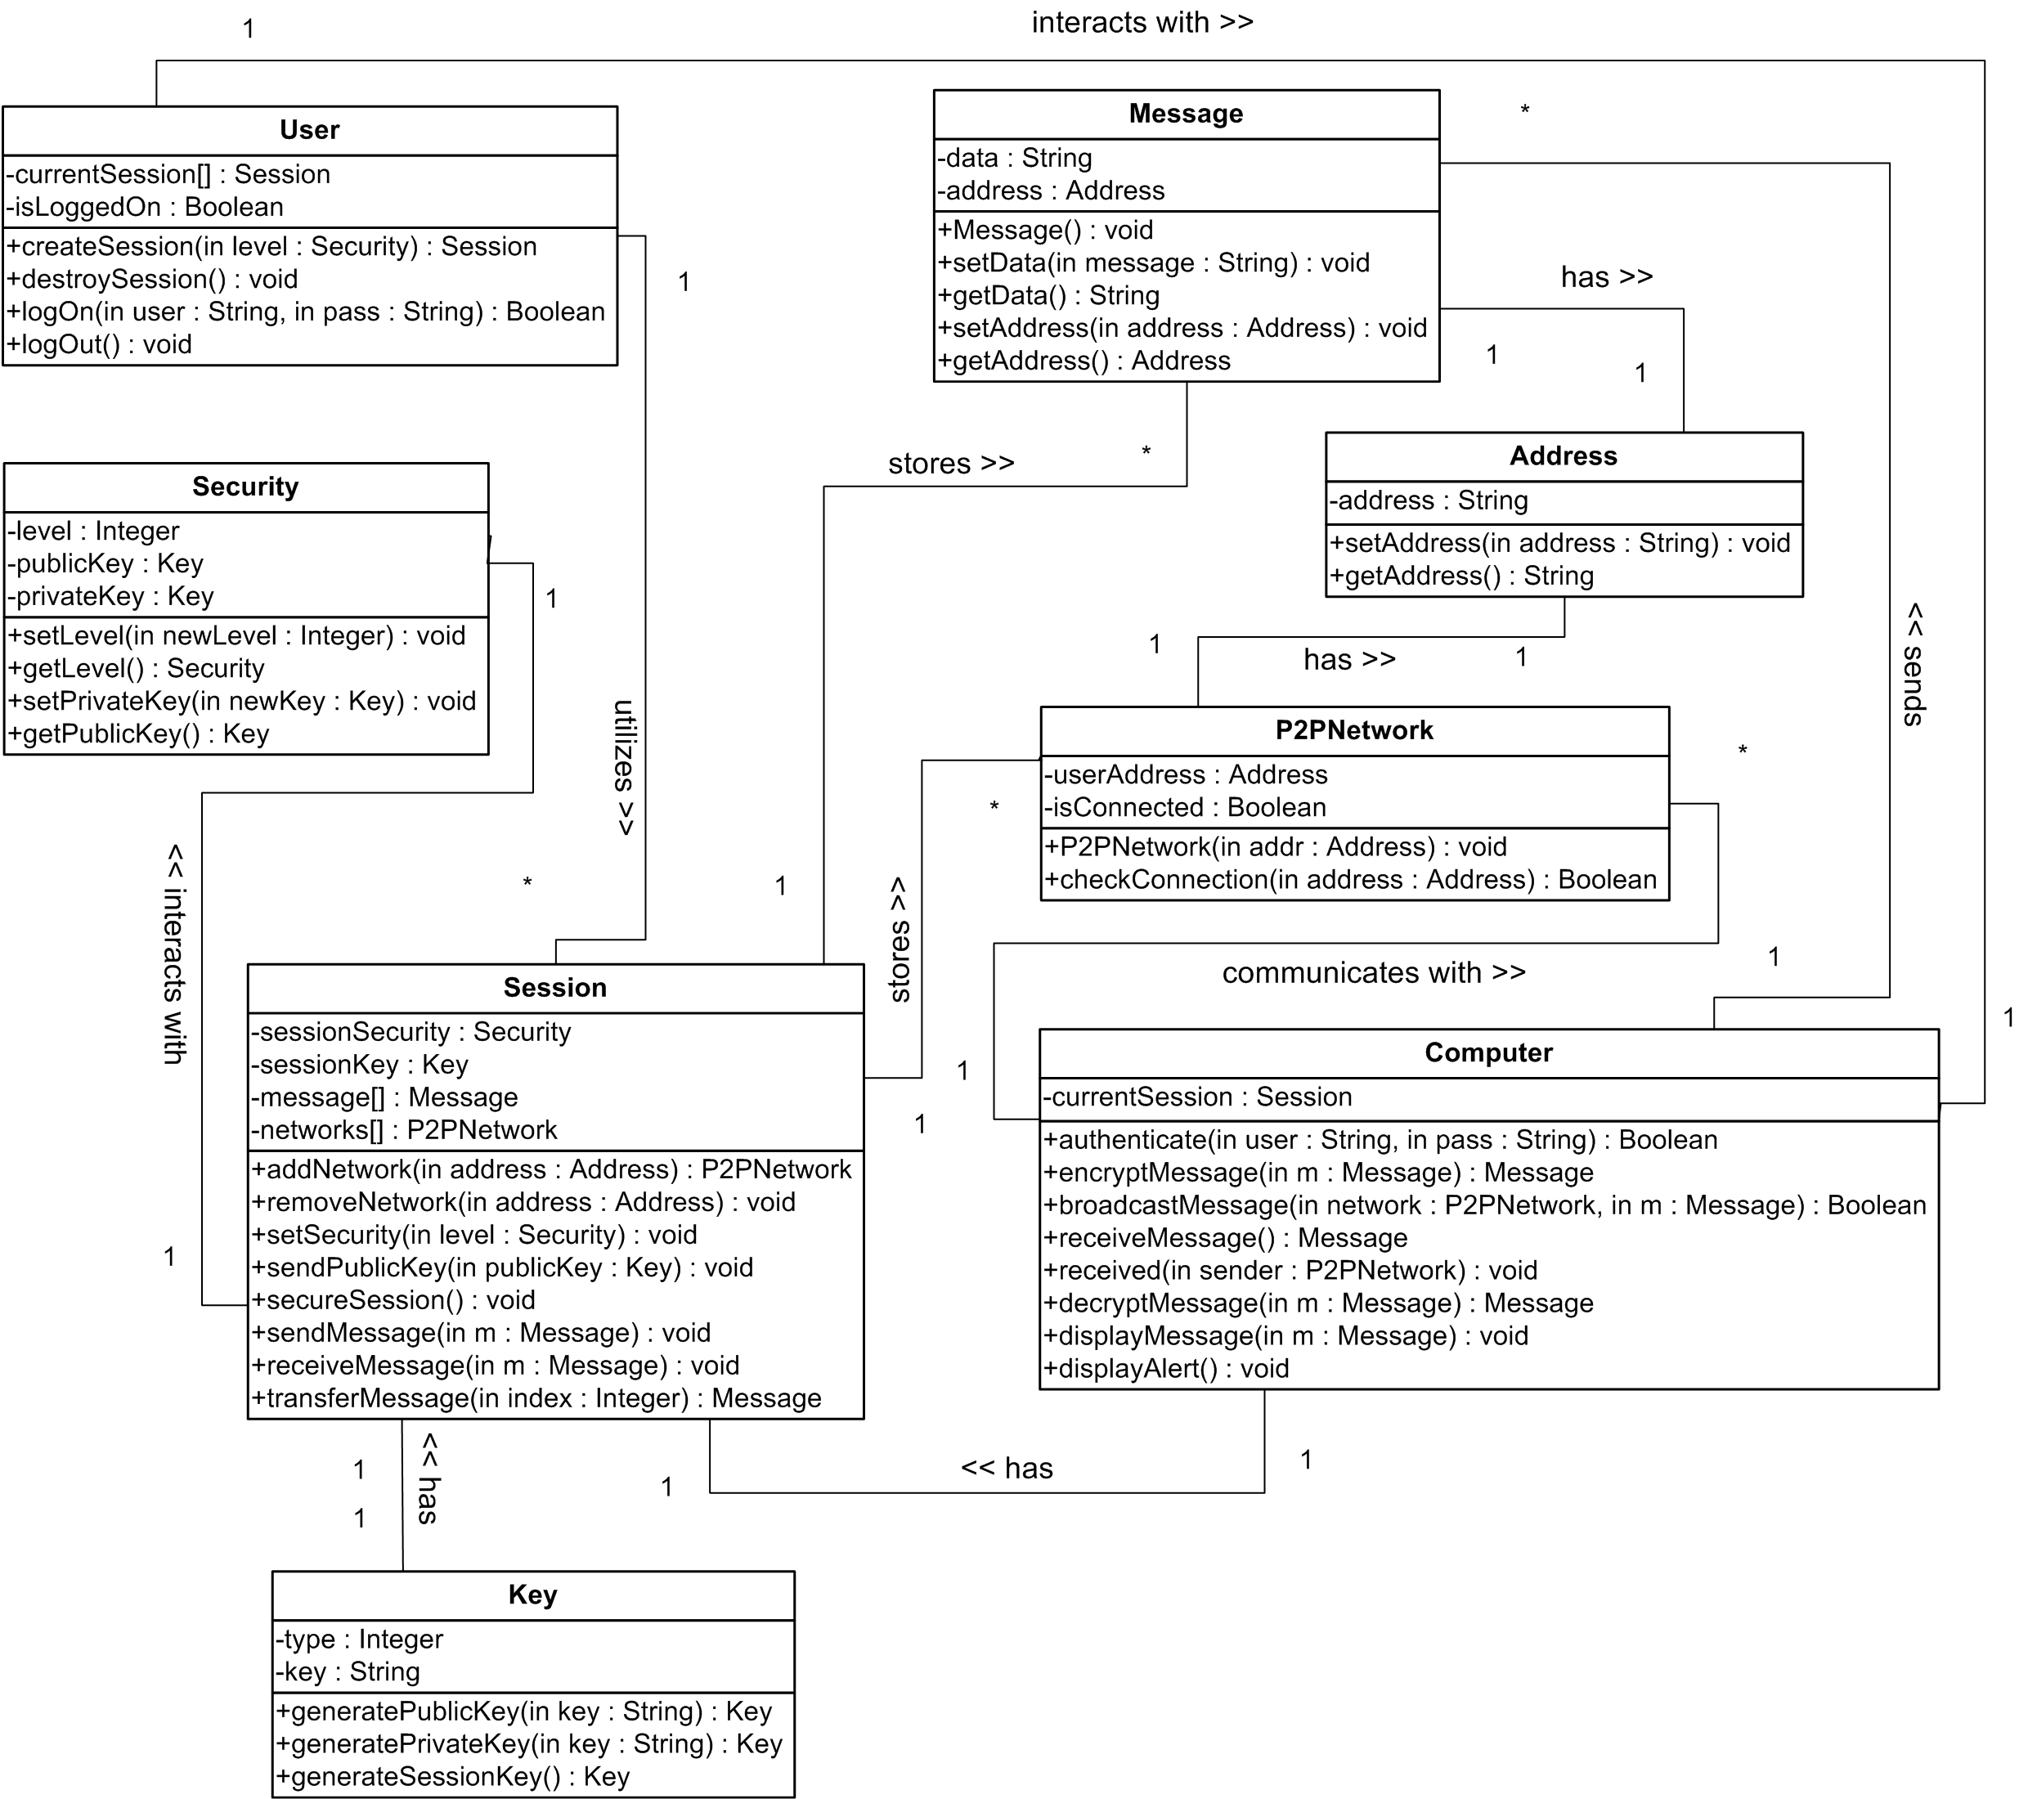

Slide 8
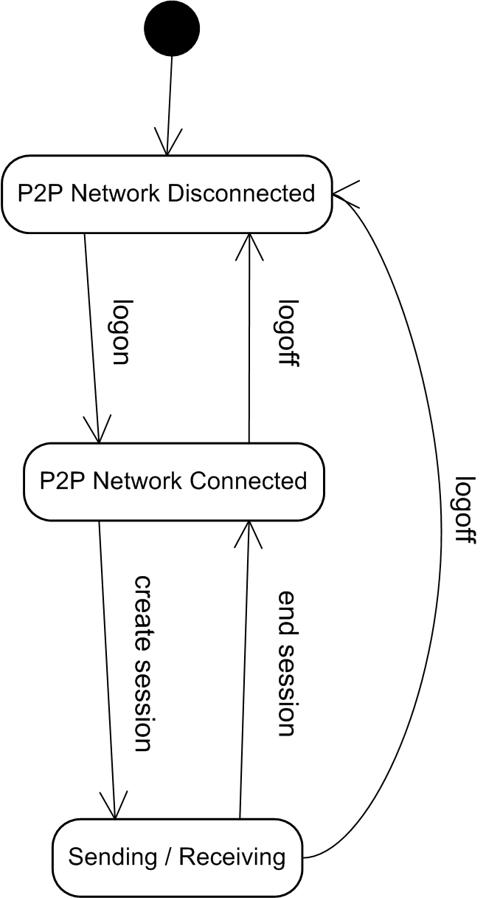
State Diagram: Program

Slide 9
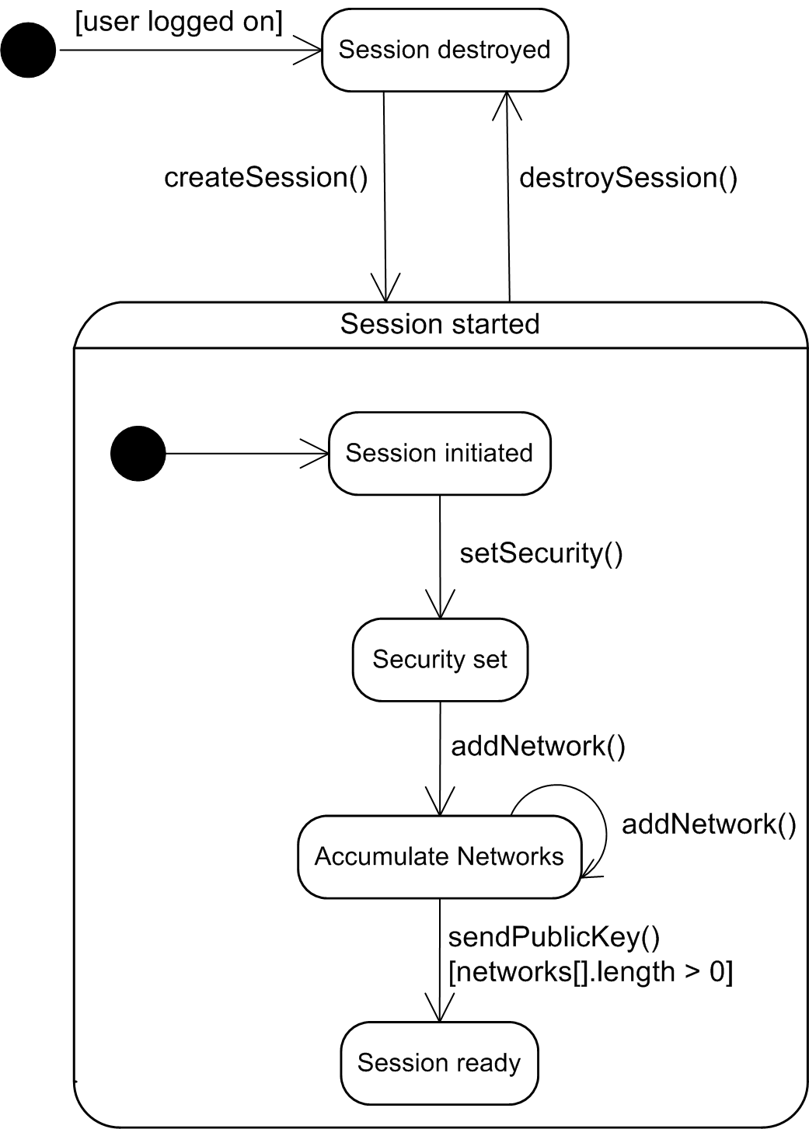
State Diagram: Session

Slide 10
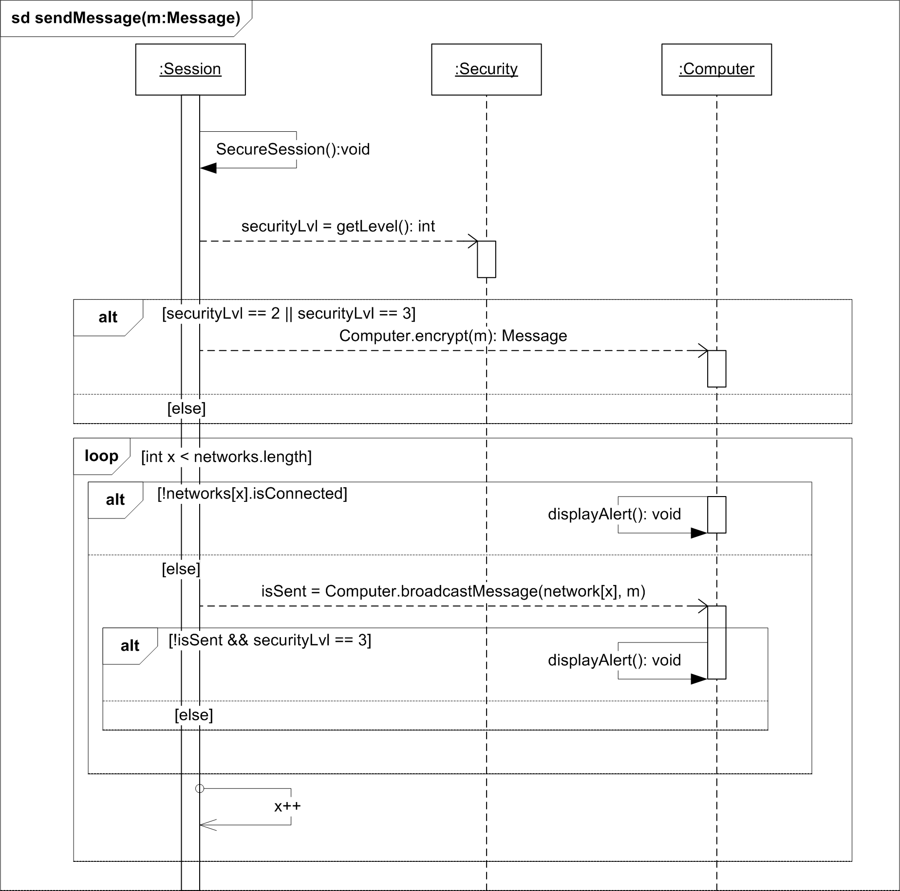
Sequence Diagram: Send Message

Slide 11
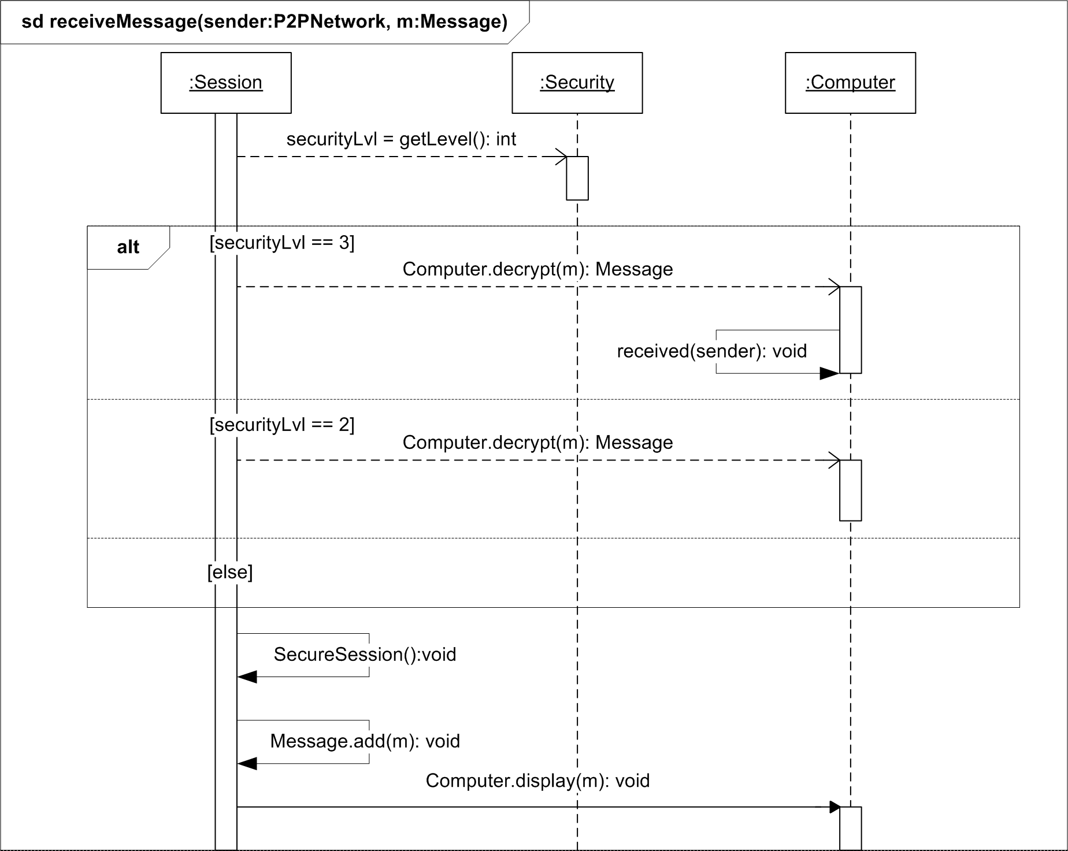
Sequence Diagram: Receive Message

Slide 12
What did we learn?

